Slide 1
Green House Monitoring and Controlling System

Slide 2
Agenda
Introduction
Features of the automated green house system
Advantages of an IoT system
Disadvantages of an IoT system
Used technologies (Used language & software tool & MC & power supply & access technology & connections )
Why ESP32 instead NODE MCU
Why Arduino IoT cloud instead Blynk IoT

Slide 3
Agenda
Automated Lightning system
Automated Security system
Automated Temperature controlling system
Automated Watering system
Circuit diagram
Source code
Dashboards
conclusion

Slide 4
Introduction
An automated IoT (Internet of Things) greenhouse is a technologically advanced agricultural facility designed to optimize and control the environment within the greenhouse to support better plant growth. It leverages a network of interconnected sensors, actuators, and control systems to monitor and adjust various environmental parameters

Slide 5
Advantages
Can change environment states for better plant growth
Reduce human involve
Can control remotely
Real time data monitoring
Data analysis and make decisions

Slide 6
Features of the automated green house system
Automated Lightning system
Automated Security system
Automated Temperature controlling system
Automated Watering system

Slide 7
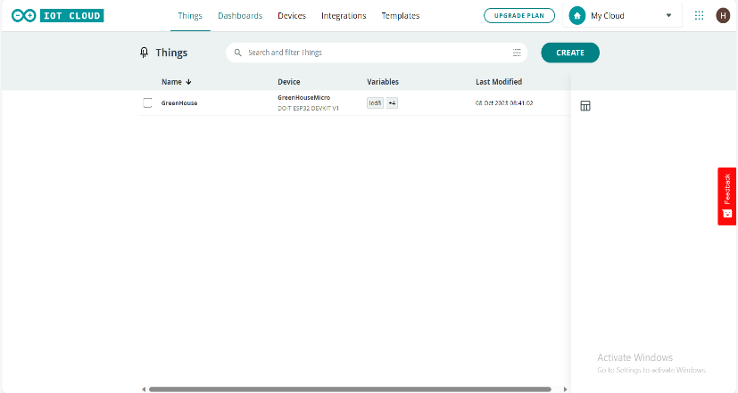
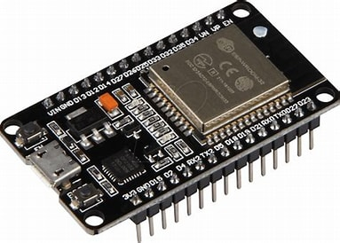
What I used
Used language & software tool
MC
Arduino IoT cloud
ESP 32 DEVKITV1
+ Micro USB cable

Slide 8
Why ESP32 instead NODE MCU?

Slide 9
Why ESP32 instead NODE MCU?
More Processing Power
More Memory
Dual-Core Architecture
Built-In Bluetooth
Improved Power Efficiency
More GPIO Pins
Integrated Touch Sensing
Better Networking Performance
Wider Range of Supported Protocols
Development Ecosystem
Long-Term Support

Slide 10
Why Arduino IoT cloud instead Blynk IoT

Slide 11
Why Arduino IoT cloud instead Blynk IoT
Simplicity and Ease of Use
IoT Device Management
Arduino Ecosystem Integration
Security
Scalability
Official Support and Documentation
Integration with Other Arduino Services

Slide 12
What I used
access technology
WIFI

Slide 13
Automated Lightning system
IoT greenhouses often use a combination of natural and artificial lighting. Sensors measure the intensity and duration of sunlight, and automated shading systems can be adjusted to control the amount of light reaching the plants.
consider
1) For humans
2) For trees

Slide 14
1) Light control using virtual switch
2) Control light’s brightness using virtual meter
3) Light control using LDR
LDR changes its resistance in response to changes in light intensity, we can use to light control
Components
LED
LDR sensor

Slide 15
Automated security system
A security system using a touch sensor is designed to detect and respond to physical touch or contact with an object or surface. It can be used to secure doors, windows, cabinets, or other access points by triggering an alarm or notification when unauthorized contact is made.
components
Touch sensor
buzzer

Slide 16
Automated watering system
Soil moisture sensors detect the moisture levels in the growing medium, ensuring that plants receive the right amount of water. Automated irrigation systems can adjust the frequency and duration of watering.
Components
Soil moisture sensor
Water Pump actuator
A Horse
water
A Plant

Slide 17
Automated temperature controlling system
The greenhouse is equipped with sensors that monitor temperature and humidity. Based on the data collected, the system can automatically adjust the heating and cooling systems to maintain ideal conditions for plant growth.
Components
DH11 temperature sensor
DC fan
Heat element

Slide 18
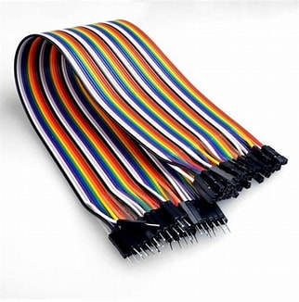
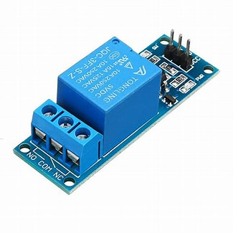
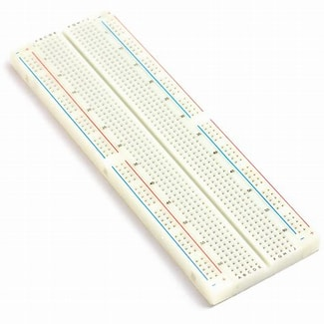
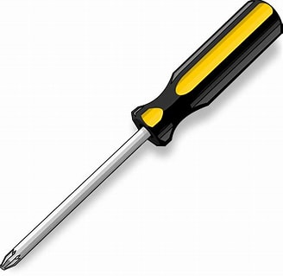
What I used
connectivity
Bread board
Jumper wires (all 3 types)
Relay modules
Screwdriver

Slide 19
Circuit diagram

Slide 20
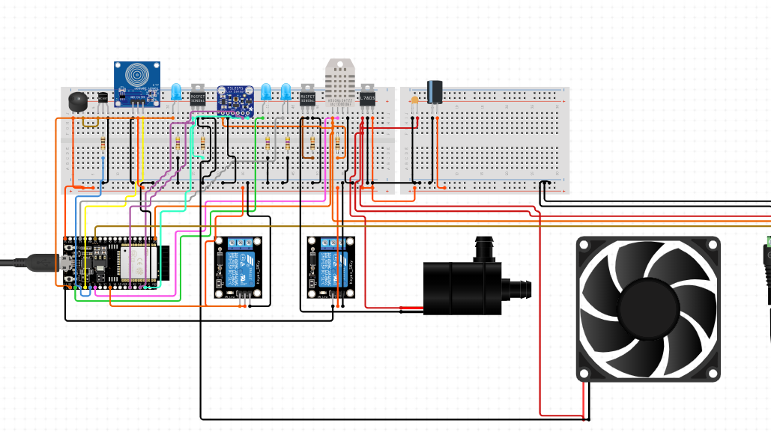

Slide 21
Dashboards

Slide 22
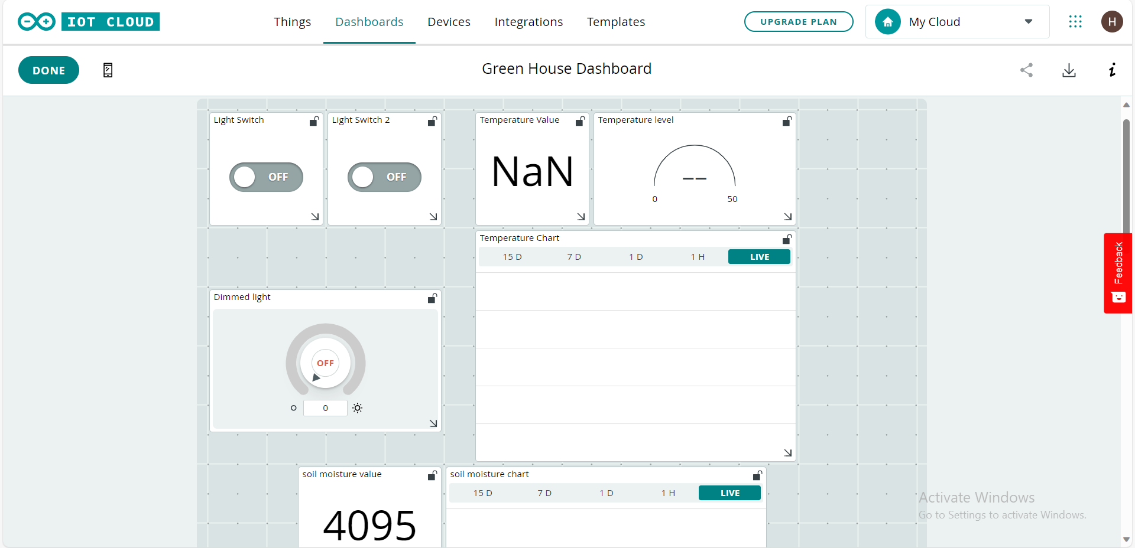
Web dashboard

Slide 23
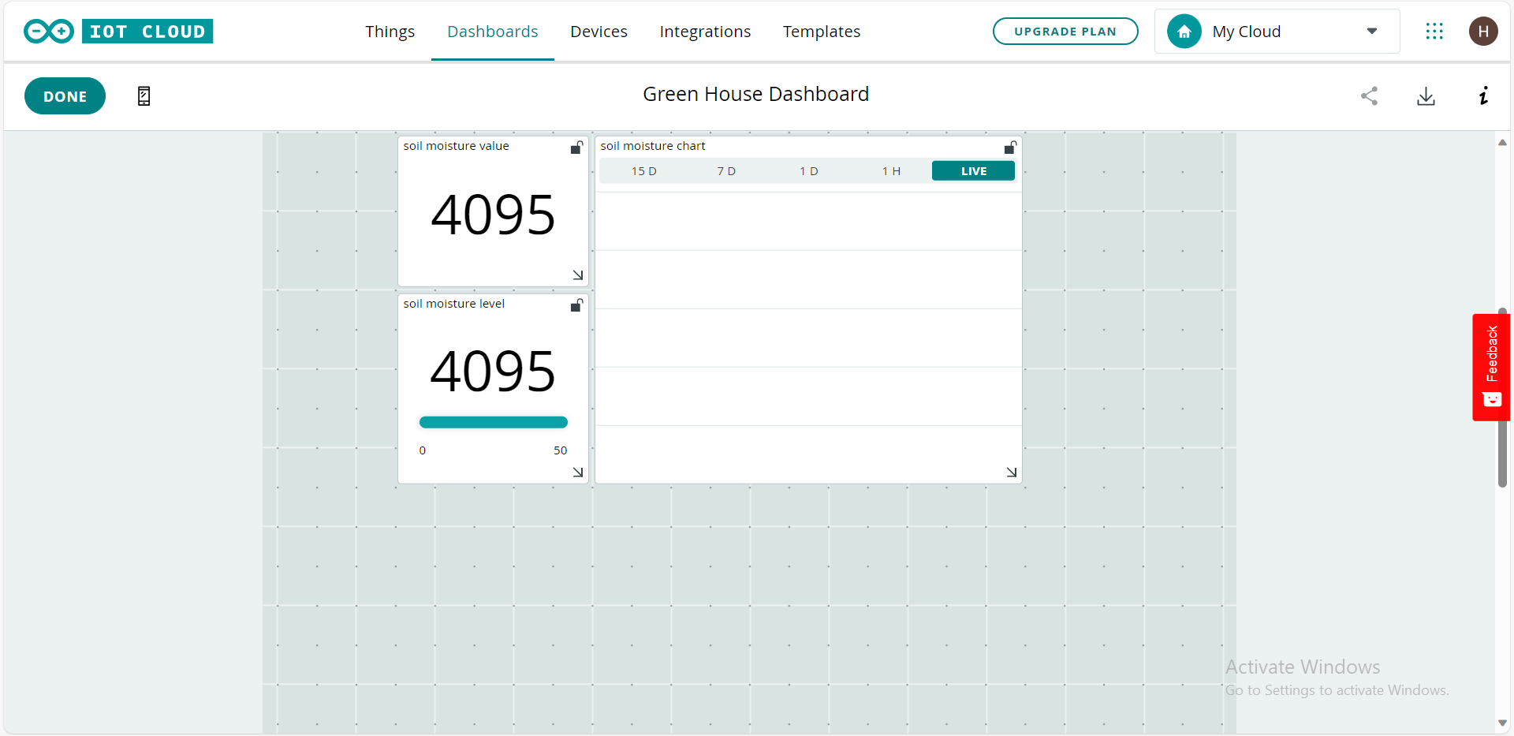
Web dashboard

Slide 24
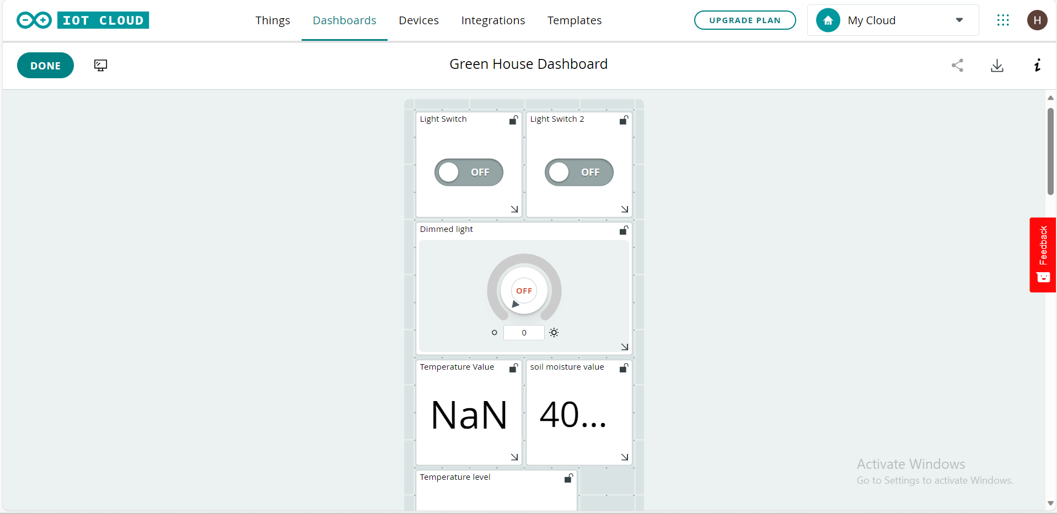
Mobile dashboard

Slide 25
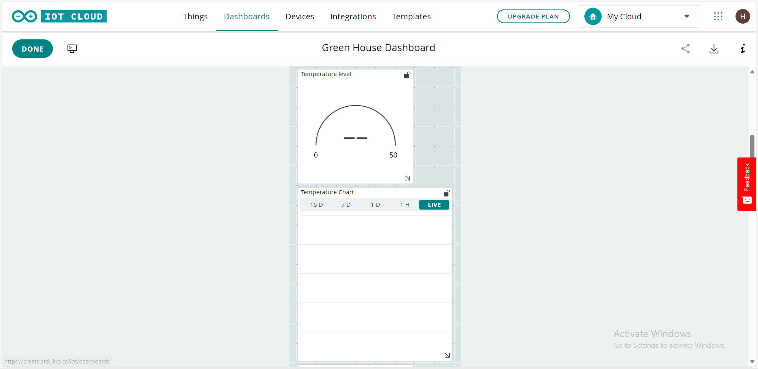
Mobile dashboard

Slide 26
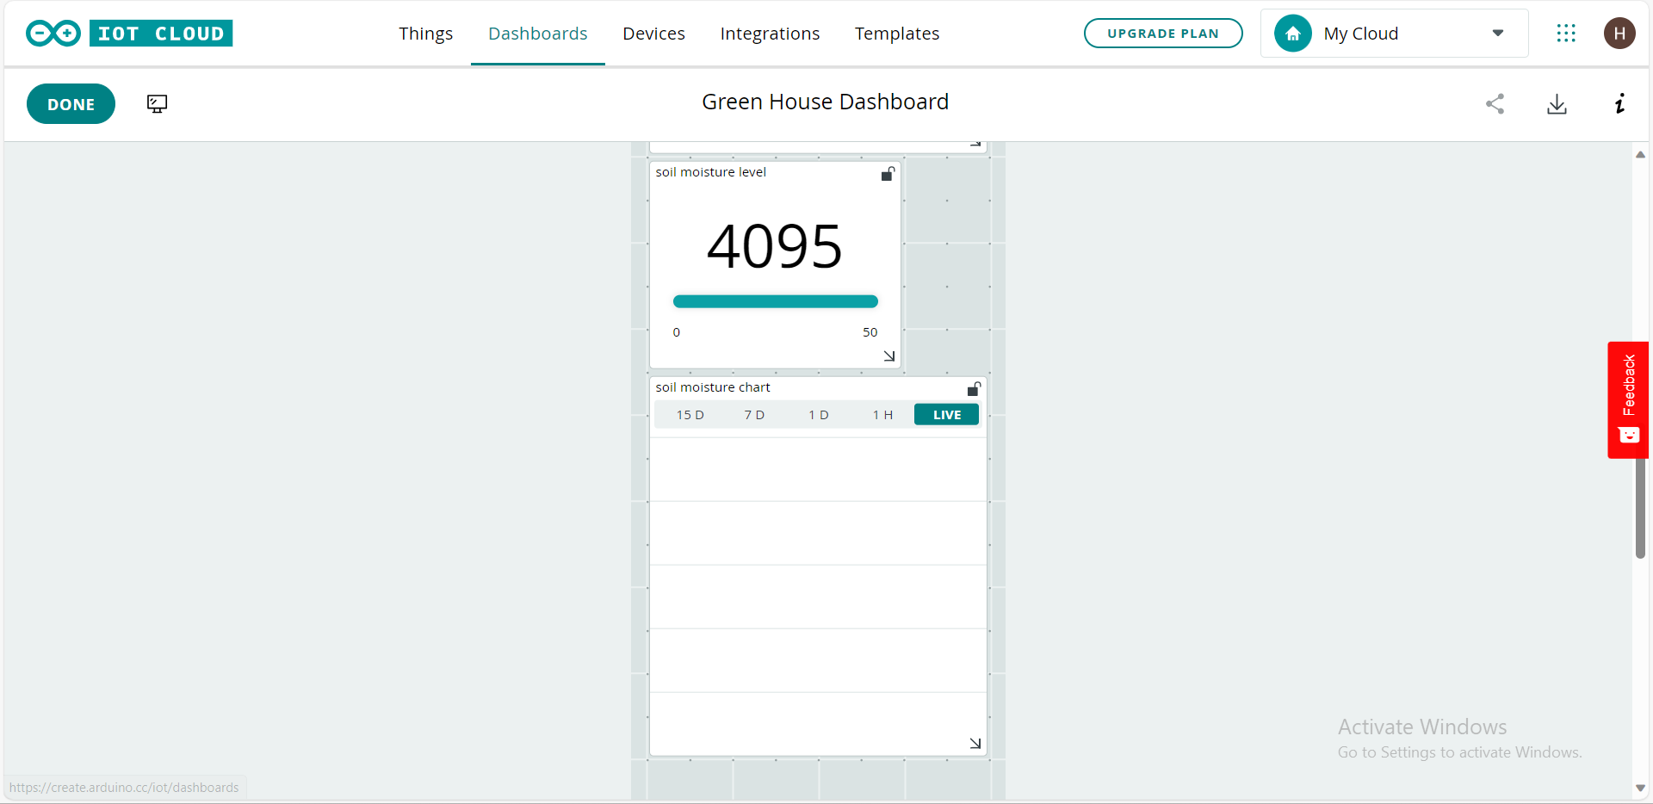
Mobile dashboard

Slide 27
Source code

Slide 28
#include <DHT.h>
#include <DHT_U.h>
CloudDimmedLight led3;
CloudTemperatureSensor temperature;
int soil_moisture;
bool led;
bool led2;
#include "thingProperties.h"
int led_pin = 2;
int led_pin2 = 4;
int led_pin3 = 5;
int brightness;
int ldr_pin = 21;
int led_pin4 = 14;
#define DHT_SENSOR_PIN 13
#define DHT_SENSOR_TYPE DHT11
DHT dht_sensor(DHT_SENSOR_PIN,DHT_SENSOR_TYPE);
int relay1_pin = 23;
int touch_pin = 32;
int buzzer_pin = 18;
int soil_moisture_pin = 34;
int relay2_pin = 15;
int fan_pin = 19;

Slide 29
void setup() {
Serial.begin(9600);
pinMode(led_pin , OUTPUT);
pinMode(led_pin2 , OUTPUT);
pinMode(ldr_pin , INPUT);
pinMode(led_pin3 , OUTPUT);
pinMode(led_pin4 , OUTPUT);
pinMode(DHT_SENSOR_PIN , INPUT);
dht_sensor.begin();
pinMode(relay1_pin , OUTPUT);
pinMode(touch_pin , INPUT);
pinMode(buzzer_pin , OUTPUT);
pinMode(soil_moisture_pin , INPUT);
pinMode(relay2_pin , OUTPUT);
pinMode(fan_pin , OUTPUT);
delay(1500);
initProperties();
// Connect to Arduino IoT Cloud
ArduinoCloud.begin(ArduinoIoTPreferredConnection);
setDebugMessageLevel(2);
ArduinoCloud.printDebugInfo();
}

Slide 30
void loop() {
ArduinoCloud.update();
if(digitalRead(ldr_pin)==1)
{
digitalWrite(led_pin4, HIGH);
}
else
{
digitalWrite(led_pin4, LOW);
}
float humidity=dht_sensor.readHumidity();
Serial.print("Humidity");
Serial.print(humidity);
temperature=dht_sensor.readTemperature();
Serial.print("Tempereture");
Serial.print(temperature);

Slide 31
if(temperature<25)
{
digitalWrite(relay1_pin, HIGH);
}
else
{
digitalWrite(fan_pin, HIGH);
}
//security system
if(digitalRead(touch_pin)==1)
{
digitalWrite(buzzer_pin, HIGH);
}
else
{
digitalWrite(buzzer_pin, LOW);
}
//irrigation system

Slide 32
soil_moisture = analogRead(soil_moisture_pin);
if(soil_moisture>1200)
{
digitalWrite(relay1_pin, HIGH);
}
else
{
digitalWrite(relay1_pin, LOW);
}
delay(2000);
}
void onLedChange() {
if (led)
{
digitalWrite(led_pin, HIGH);
}
else
{
digitalWrite(led_pin, LOW);
}
}

Slide 33
void onLed2Change() {
if (led2)
{
digitalWrite(led_pin2, HIGH);
}
else
{
digitalWrite(led_pin2, LOW);
}
void onLed3Change() {
brightness=led3.getBrightness();
if(brightness>0)
{
analogWrite(led_pin3, brightness);
}
}

Slide 34
Conclusion
In summary, an automated IoT greenhouse has the potential to revolutionize agriculture by precisely controlling environmental factors, leading to better plant growth, increased crop yields, and reduced resource wastage. These smart greenhouses can significantly contribute to sustainable and efficient food production.

Slide 35
THANK YOU

